Slide 1
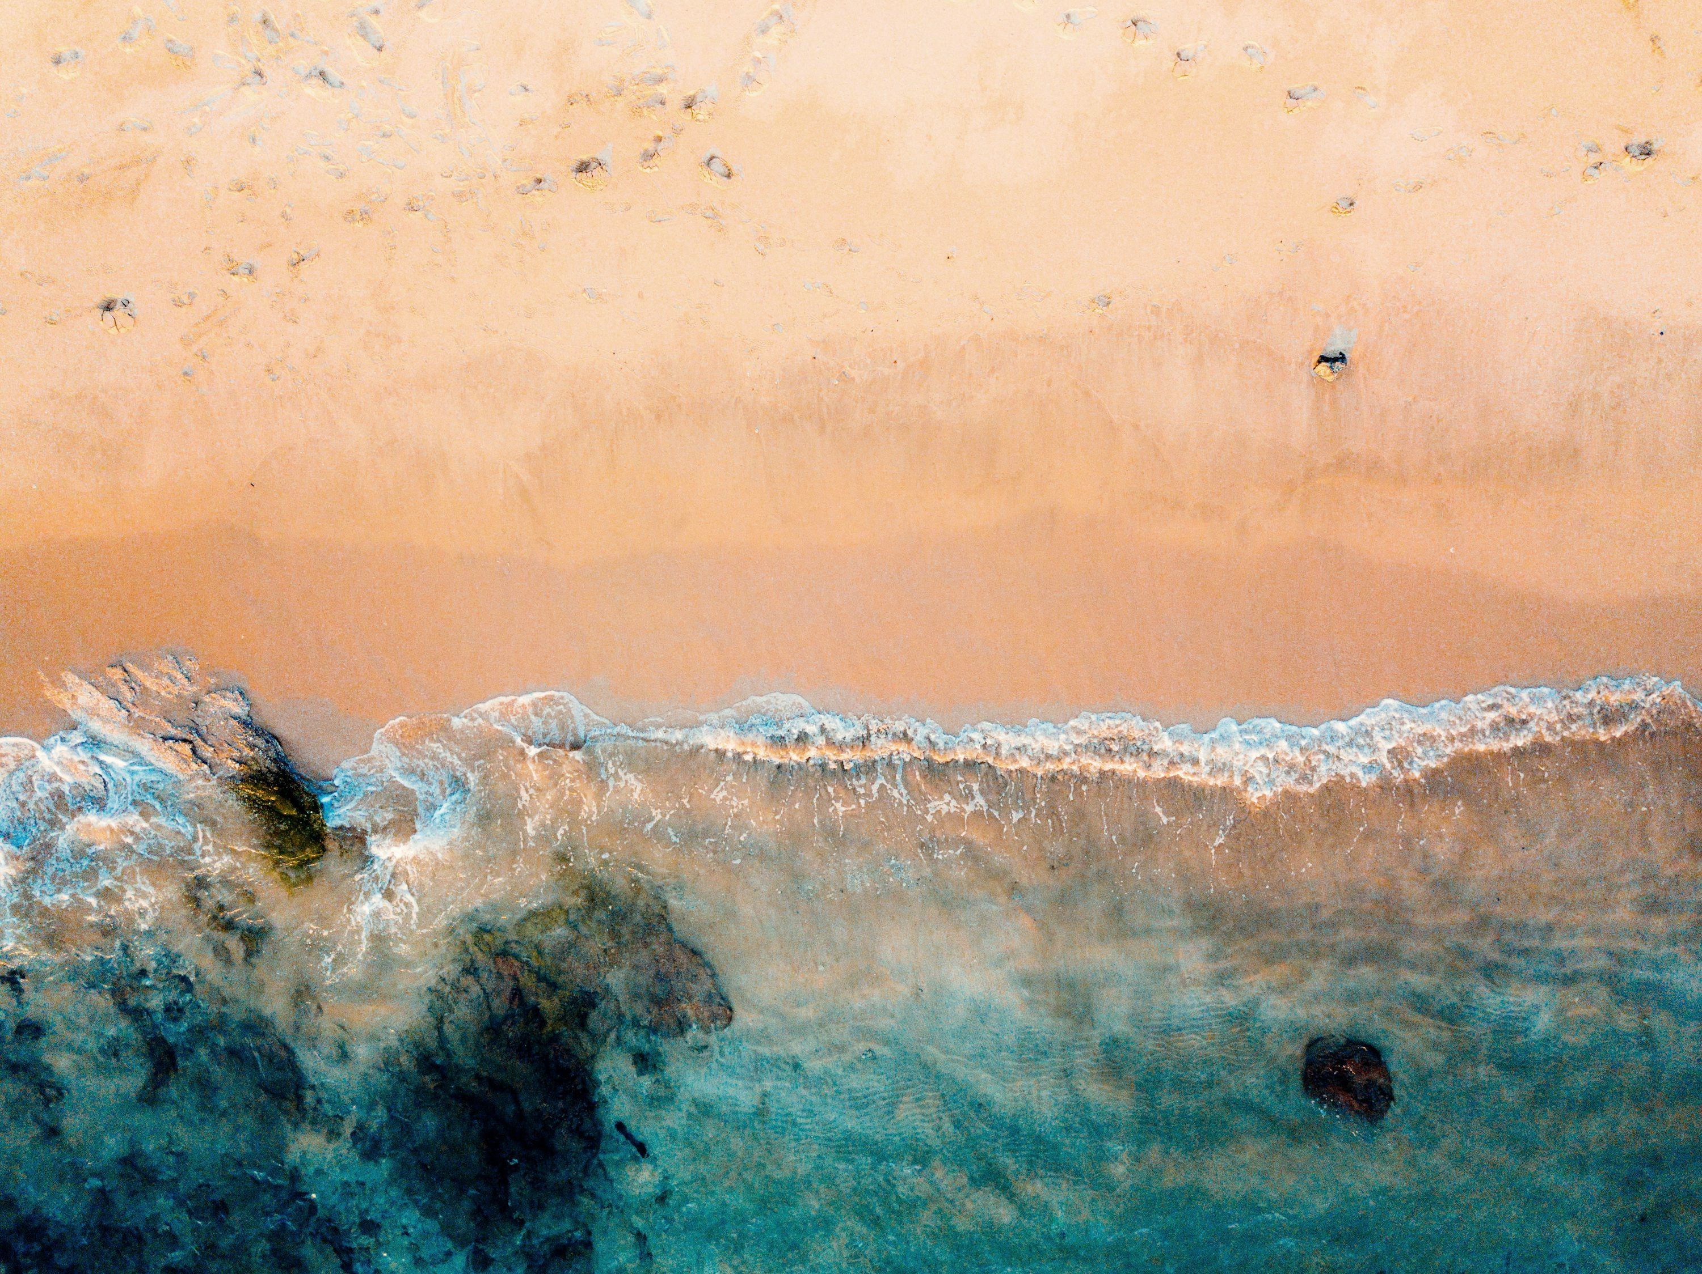




Slide 2
Login
Login
Username / email
password
Login
Register

Slide 3
Register
Register
Beachgoer
lifeguard
Beachgoer
lifeguard
Username
Username
email
email
Password
Password
Confirm password
Confirm password
Lifegard certificate identification
Create account
Create account

Slide 4


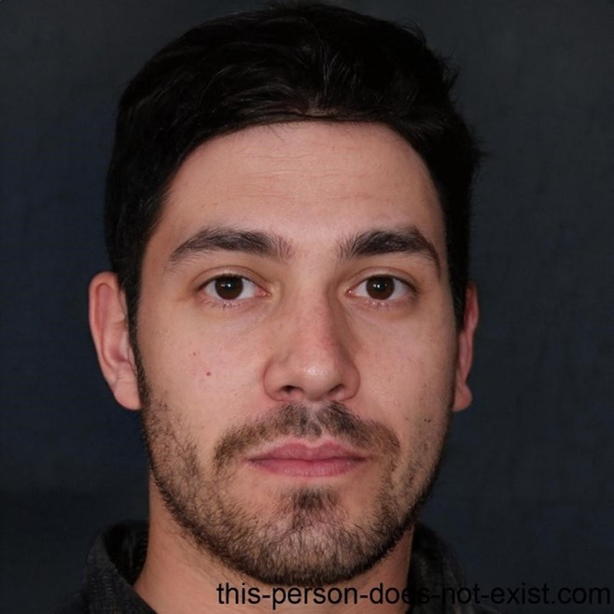


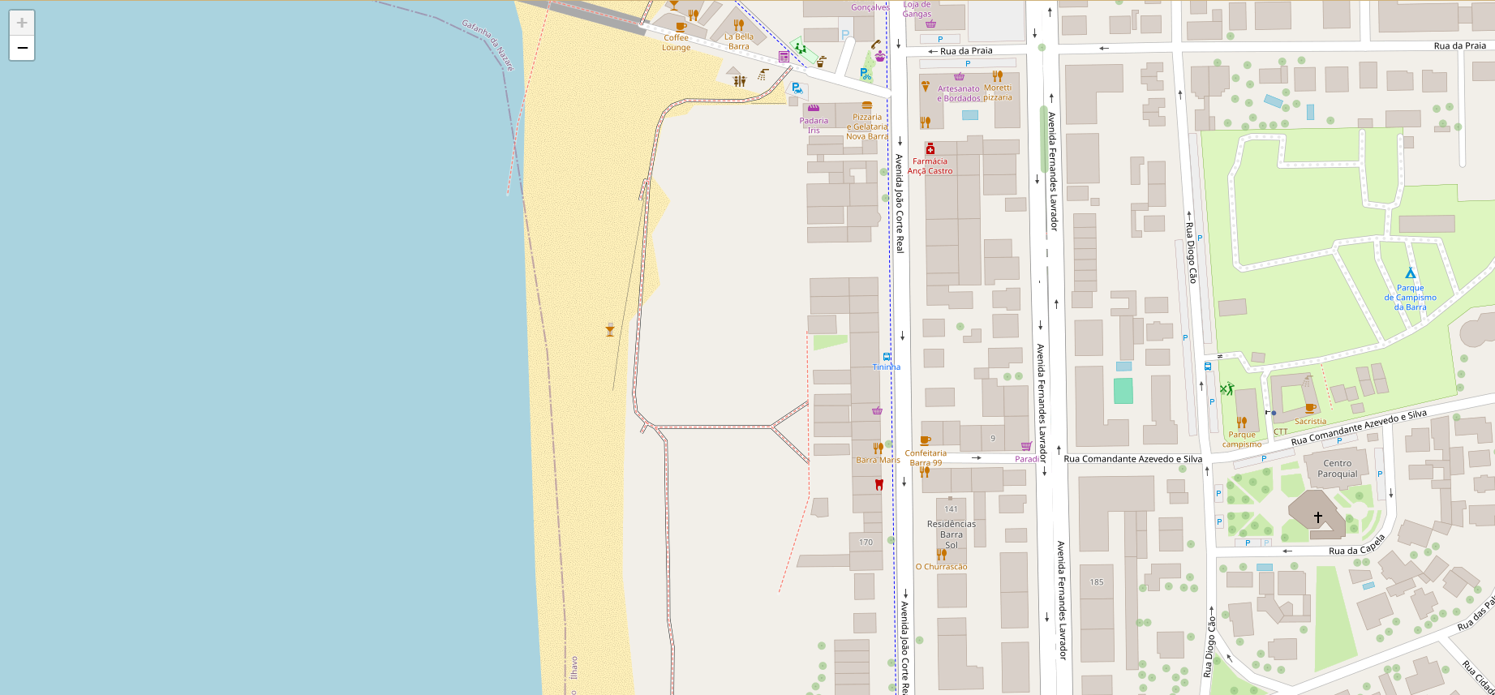









Temp. 20 ºC
0

Slide 5

Temp. 20 ºC
0

Slide 6

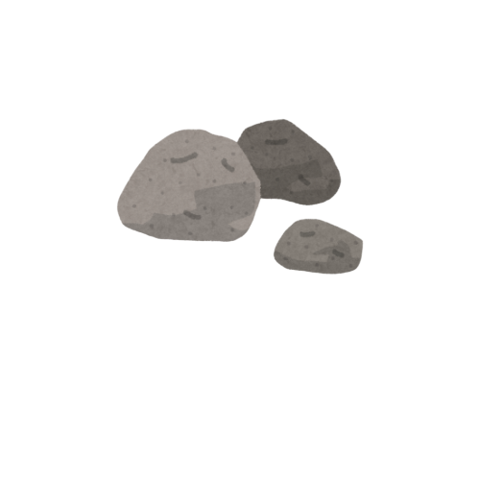

Legenda
Novo perigo
Posto de Vigia
Posto de Socorro
Nadador Salvador
Bar / Restaurante
Vendedor Ambulante
Casa de Banho / WC
Animais
Rochas
Lixo perigoso
Novo perigo
Nome:
Inserir
Voltar
Voltar

Slide 7
Notificações
Notificações
Novo perigo no areal.
Nova mensagem de Joana Silva
Voçê não tem novas notificações

Slide 8


Slide 9

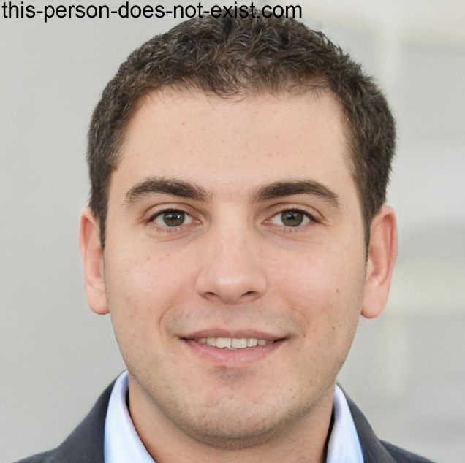
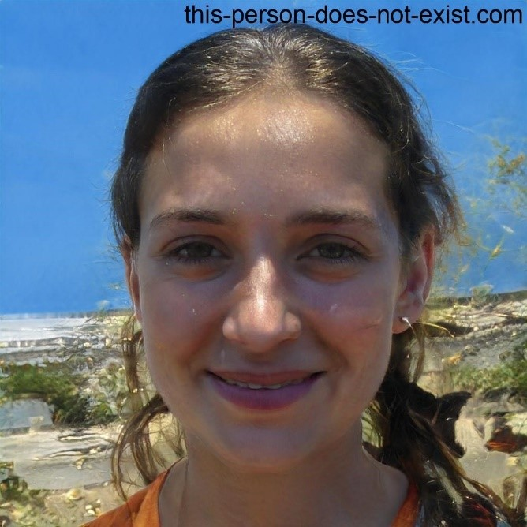
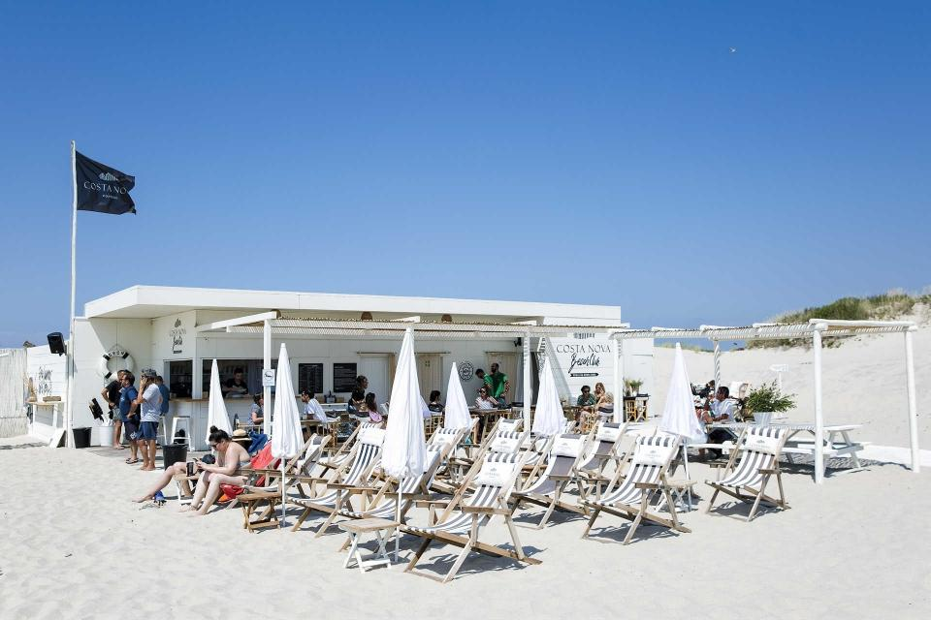



Posto nº 1
Posto nº 1
Posto Socorro
Nadador Salvador
Nome: Joao Gomes
Exp.: 3 Ano
Veterano
Team
Ask for help
Bar Ramiro
Comida | Bebida
WC
Nadador Salvador
Nadador Salvador
Nome: Miguel Soares
Nome: Joana Costa
Exp.: 5 Anos
Veterano / Supervisor
Exp.: 1 Ano
Novata
menu

Slide 10
Emergency call

Slide 11
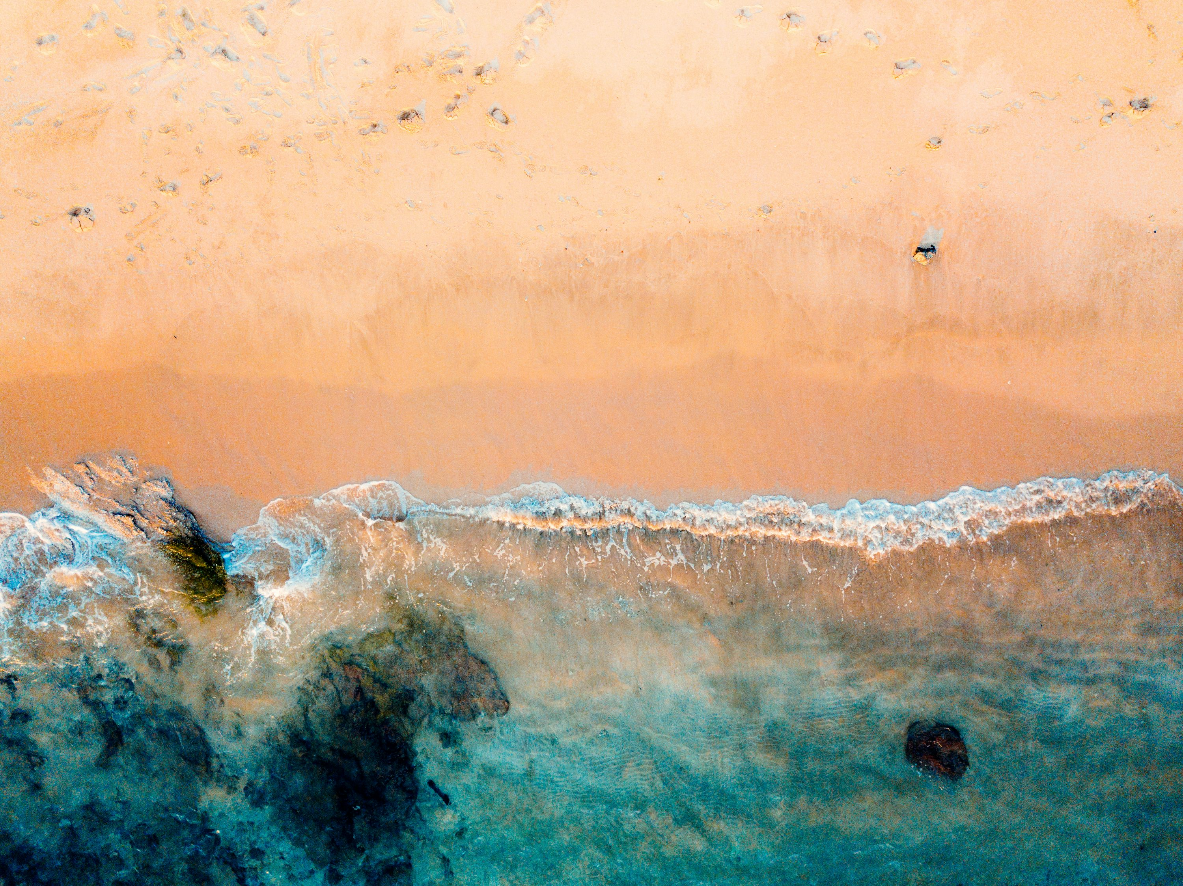


Temp. 20 ºC
Beaches
Beaches 1
Search beach
Search team
Beaches 1
Beaches 2
Team 1
Team 2
Team 3
N members
N members
N members
New team
Delete beach

Slide 12



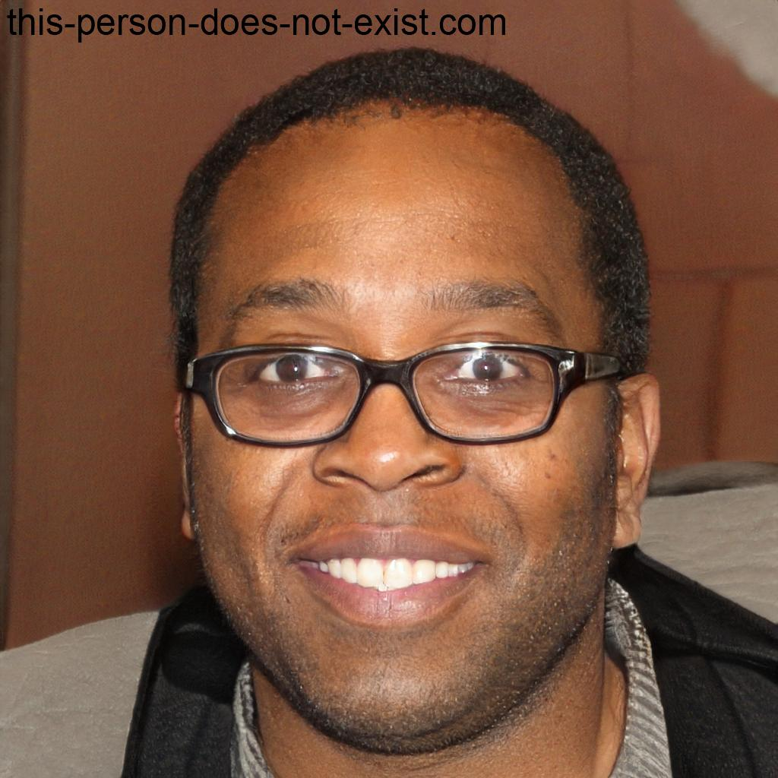

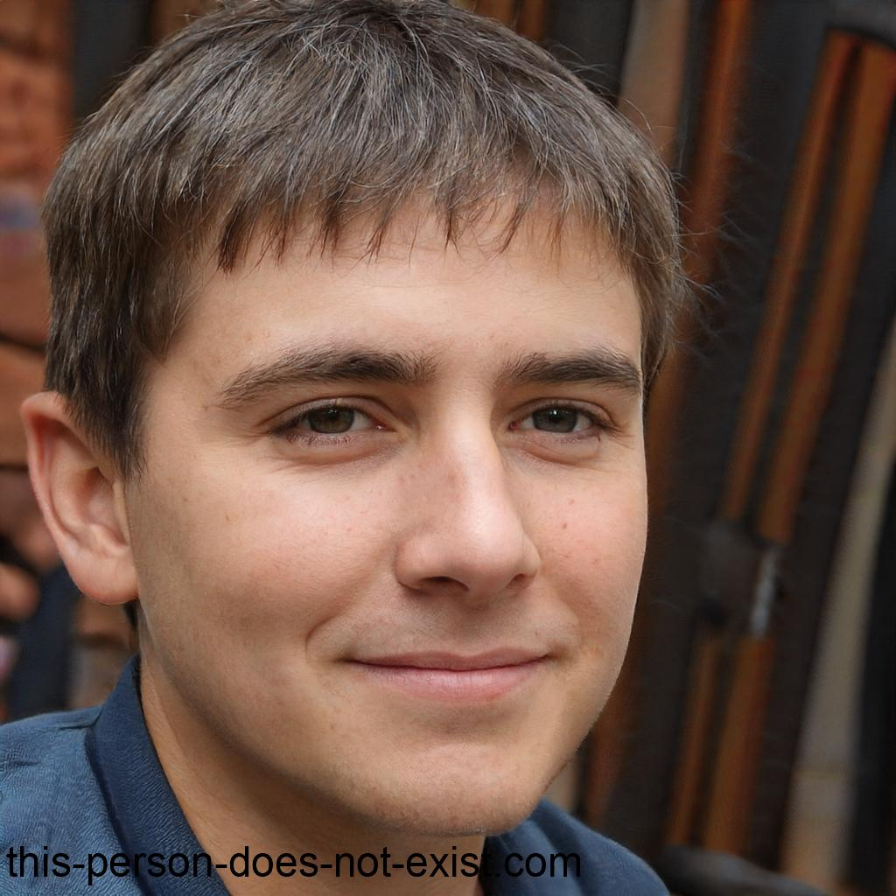
Temp. 20 ºC
Beaches
Beaches 1
Search beach
Post 1
Beaches 1
Search member
Beaches 2
Joana costa | 1 ano | None
Telmo Pires | 3 anos |
Joao Gomes | 2 anos | None
Alberto Silva | 1 anos | None
Edit team
Delete team

Slide 13
Are you shore you want to delete Post 1
New Team
Yes
No
New team name
Confirm
Cancel
Are you shore you want to delete Beach 1
New Beach
Yes
No
New beach name
Confirm
Cancel

Slide 14

Beaches 1
Post 1
Search member
Joana Costa | 1 ano | None
Telmo Pires | 3 ano |
João Gomes | 1 ano | None
Alberto Silva | 1 anos | None
Add member
Cancel

Slide 15
Beaches 1
Team 1
Search member
Joana Costa | 1 ano | None
Telmo Pires | 3 ano |
João Gomes | 1 anos | None
Add member
Cancel

Slide 16


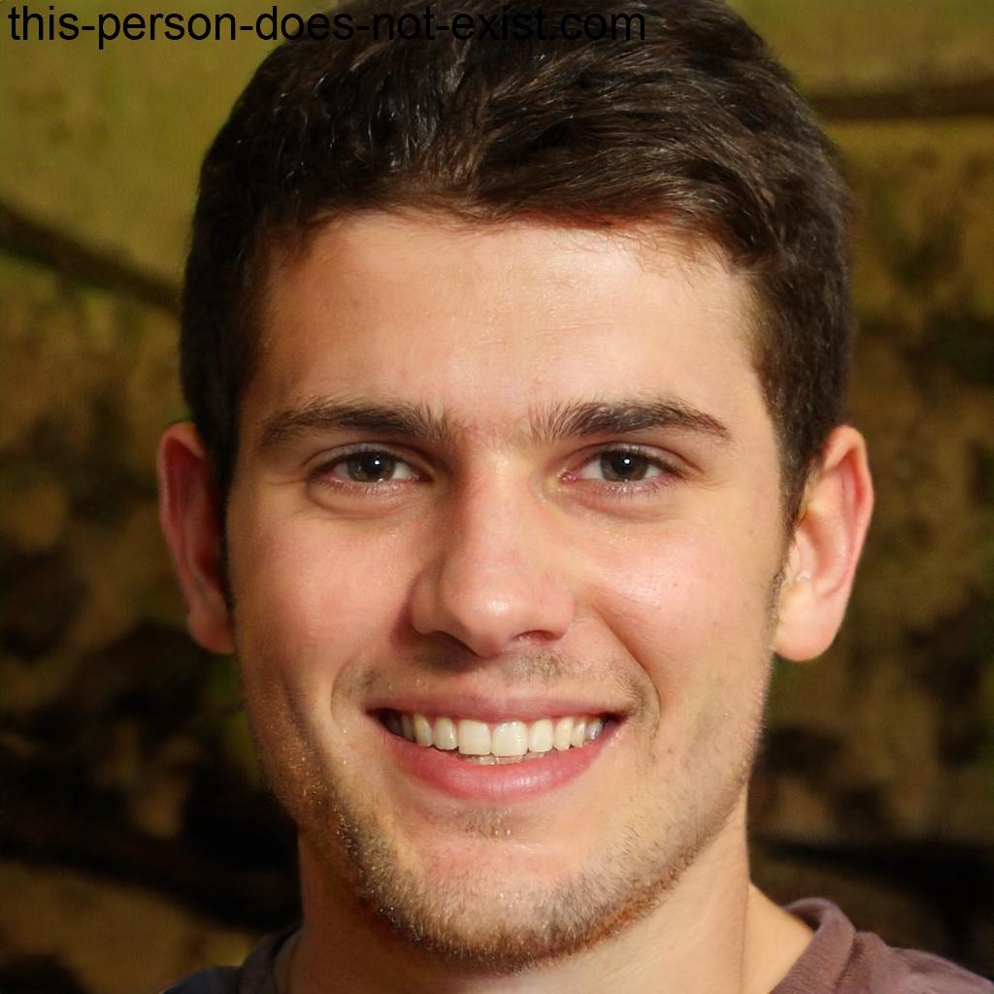

w
Search member
Miguel Soares | 5 ano |
Ruben Pinto | 3 ano |
Alberto Silva | 1 ano | None
Add
Cancel

Slide 17
Beaches 1
Post 1
Search member
Joana Costa | 1 ano | None
Telmo Pires | 3 ano |
João Gomes | 1 ano | None
Ruben Pinto | 3 ano |
Add member
Cancel

Slide 18
Temp. 20 ºC
Beaches
Beaches 1
Search beach
Post 1
Beaches 1
Search member
Beaches 2
Joana costa | 1 ano | None
Telmo Pires | 3 anos |
Joao Gomes | 2 anos | None
Ruben Pinto | 3 ano |
Edit team
Delete team

Slide 19
15/07/2025
9:16
Temp. 20 ºC
Beach 1
Post 1
weekday
Initial Time (HH:mm)
End Time (HH:mm)
Name
Insert Shift
Search member
MM
Monday | Tuesday | Wednesday | Thursday | Friday | Satur
João Gomes – 2 h 0 m
Telmo Pires
9:00 - 14:00
Ruben Pinto
10:00 - 15:30
João Gomes
10:00 - 15:30
Telmo Pires
9:00 - 14:00
Telmo Pires
9:00 - 14:00
Joana Costa – 3 h 30 m
Joana Costa
10:00 - 15:30
João
Gomes
9:00 - 14:00
Joana Costa
10:00 - 15:30
Ruben Pinto
10:00 - 15:30
Telmo Pires – 0 h 00 m
Ruben pinto – 0 h 00 m

Slide 20
João
Gomes
9:00 - 11:00
Monday
Tuesday
Wednesday
Thursday
Friday
Saturday
Sunday
Joana Costa
João Gomes
Telmo Pires
Ruben Pinto
João
Gomes
9:00 - 11:00
Joana Costa
9:00 - 12:30

Slide 21

Temp. 20 ºC
Beach 1
Team 1
Chat with Team
Search member
Joana
Telmo
João
Ruben
Team 1
_

Slide 22

Temp. 20 ºC
Beaches
Beach 1 historic
Search beach
nº | Day | Start | End | type | Post | State
12 | 11/03/25 | 12:00 | 13:00 | Hazard - animal | Post 1 | Pending
11 | 11/03/25 | 09:00 | 10:30 | Hazard - animal | Post 1 | Resolved
10 | 11/03/25 | 09:00 | 10:00 | Hazard - glass | Post 1 | Resolved
Beaches 1
Beaches 2
Edit

Slide 23
nº | Day | Start | End | type | Post | State
10 | 11/03/25 | 09:00 | 10:00 | Hazard - glass | 1 | Pending
11 | 11/03/25 | 09:00 | 09:30 | Hazard - animal | 1 | Resolved
Pending
Resolved
Confirm
Cancel

Slide 24

Temp. 20 ºC
Profile
Settings
Logout
Miguel Soares
MiguelSoares_1010
MiguelSoares123@gmail.com
919 952 310
Male
000001
Edit

Slide 25
Change Foto
Name
Username
email
Password
Confirm password
Sex
Lifegard certificate identification
Confirm
Cancel

Slide 26
Joana Costa
Female
ID:12345

Slide 27
d
Settings

Slide 28
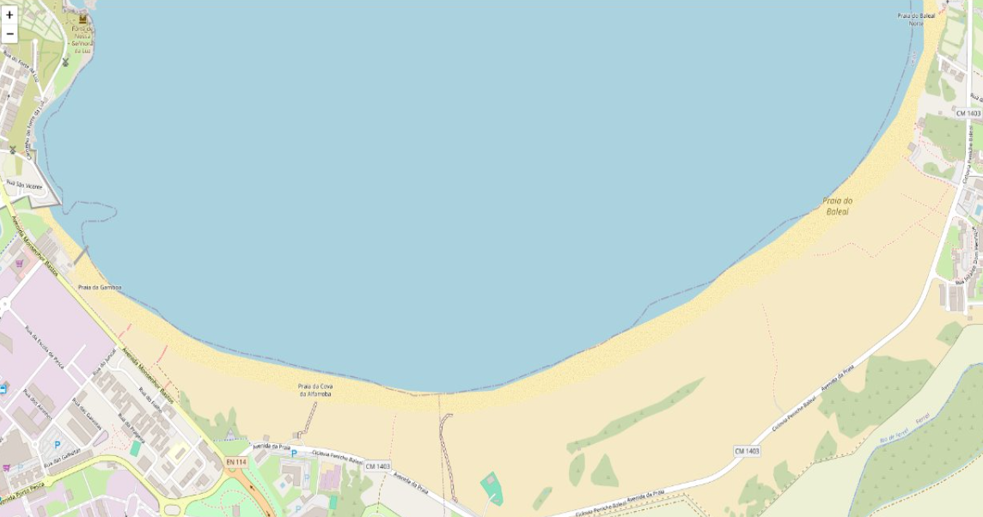


Temp. 20 ºC
0

